Slide 1
Web Development
Layout using CSS Grid Layout

Slide 2
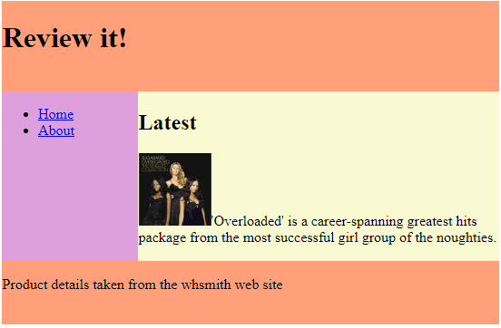
CSS Grid Layout
Uses a grid to achieve page layout
Lays out page components in rows and columns in a fully flexible fluid way that adapts to screen width
Supported by most recent versions of browsers except IE
To use grid
Work out what grid you need
Create a grid container and apply the CSS display: grid
Children of the container become grid items
Set-up the grid columns and rows that we need
Assign the grid items to areas of the grid

Slide 3
Grid container example
v
Set-up the grid container
Turn the grid container into a CSS grid
<div id="gridContainer">
<header>
<h1>Review it!</h1>
</header>
<nav>
…
</nav>
<main>
<h2>Latest</h2> …
</main>
<footer>
<p>Product …</p>
</footer>
</div>
#gridContainer {
display: grid;
}

Slide 4
Columns and row tracks
150px
1fr
Create the columns and rows (tracks) we need and specify their width and height using
grid-template-rows
grid-template-columns
100px
1fr
Track size values:
px, em, %, fr, auto,
min-content, max-content,
min-max(), fit-content()
100px
We can also name each track
#gridContainer {
display: grid;
grid-template-rows: [header-start] 100px [content-start] 1fr [footer-start] 70px;
grid-template-columns: [nav] 150px [main] 1fr;
}

Slide 5
Grid areas
“header | header”
“nav | main”
“footer | footer”
We can assign names to areas of the grid using grid-template-areas
Provide a list of names for every cell in a grid row
When neighbouring cells share a name they form a grid area with that name
#gridContainer {
display: grid;
grid-template-rows: [header-start] 100px [content-start] 1fr [footer-start] 70px;
grid-template-columns: [nav] 150px [main] 1fr;
grid-template-areas:
"header header"
"nav main"
"footer footer";
}
header
nav
main
footer

Slide 6
Placing grid items
Finally we need to position (assign) our HTML items (like <header>) into the named grid areas using grid-area
header
nav
main
header {
grid-area: header;
}
nav {
grid-area: nav;
}
main {
grid-area: main;
}
footer {
grid-area: footer;
}
footer
Here the grid areas are shown in grey boxes. In this example, their names happen to be the same as those of the HTML elements that we want to put in them

Slide 7
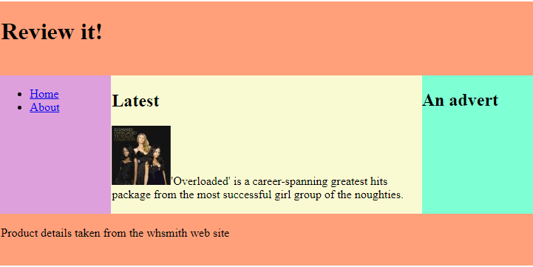
We can create a range of grids
Grid is a very useful tool. We can create a range of grids (for example: 2 columns, 3 rows; 3 columns, 3 rows; 2 columns, 2 rows etc.) depending on what layout we need

